Slide 1
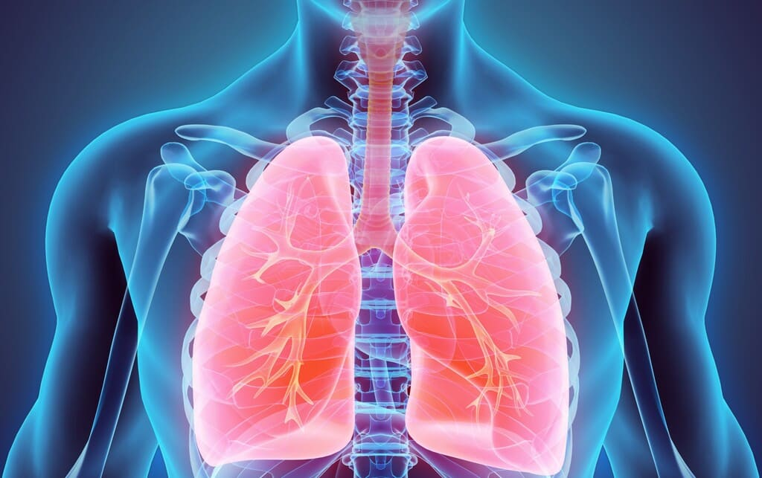
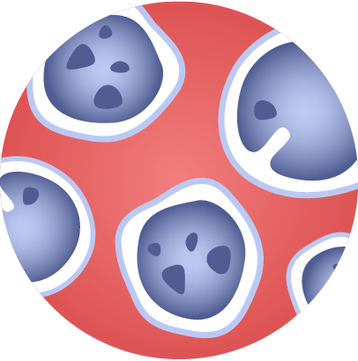
Classification of Pneumonia Using Deep Autoencoder for Chest X-ray Images
Deep Learning

Slide 2
Table of contents
01
02
05
06
09
03
04
Introduction
Project Description
Data Exploration
Autoencoder
07
08
VAE
CNN
Transfer Learning Models
Results
Conclusion

Slide 3
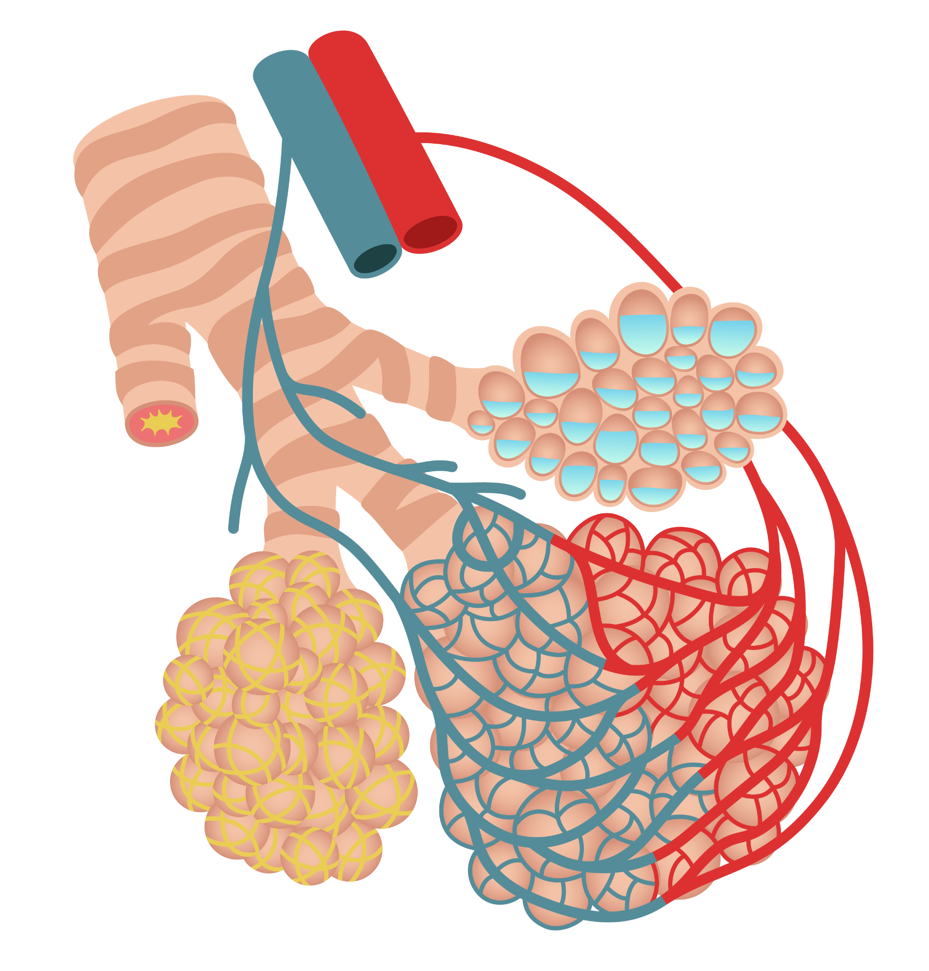
01
Introduction
Pneumonia is a respiratory disease that causes inflammation in one or both lungs, resulting in symptoms such as cough, fever, and difficulty breathing.
Deep-learning algorithms can be trained on large datasets of chest X-rays to recognize patterns and features.
Once trained, they can be used to classify new chest X-rays as either showing signs of pneumonia or not. This can be done in real time, making it a potentially valuable tool for healthcare professionals in diagnosing and treating patients with pneumonia.

Slide 4
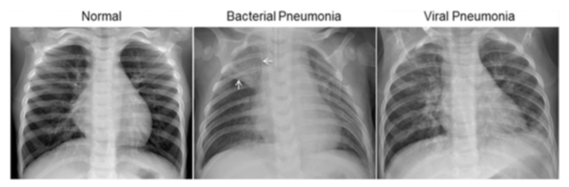
02 Project Description
Dataset
Sourced from Kaggle^{1,} it comprises 5,863 JPEG X-ray images from pediatric patients aged one to five years, categorized into Pneumonia and Normal classes.
The images are organized into 3 folders (train, test, and validation) and contain subfolders for each image category (Pneumonia/Normal).
Proposal
Perform Pneumonia classification using chest X-ray images a binary classification task to determine whether an X-ray image indicates the presence or absence of pneumonia.
The goal is that the encoder part of the autoencoder compresses the input X-ray images into a lower-dimensional latent space. Additionally, we implemented VAE, CNN and pre-trained models like VGG, ResNet and DenseNet.
Fig. 1: Examples of X-Rays in Patients with Pneumonia
¹https://www.kaggle.com/datasets/paultimothymooney/chest-xray-pneumonia
Notes:
Within this Project, we will use a dataset of X-ray images from pediatric patients, categorized into Pneumonia and Normal classes, sourced from Kaggle.
The images are divided into 3 folders: train, test, and validation, with each one containing subfolders per category.
Our proposal is to use deep learning models to classify new chest X-rays to recognize patterns and features that, once trained, can provide valuable insights for healthcare professionals to diagnose and treat pneumonia.

Slide 5
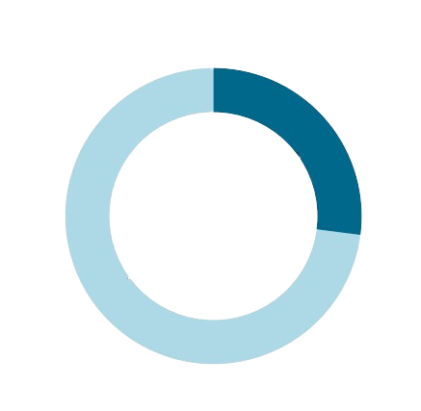
03 Data Exploration
Distribution of Classes
The dataset has originally a dataset of 4273 images of pneumonia and 1583 images of normal x-rays, so is very unbalance.
Normal
27%
The dataset was unbalanced so we resample it and got in the end 80% for train, 10% for validation and 10% test.
In order to improve it, data transformation were made on the images, like resizing them at 256x256 and adjust pixels´ scale and distribution.
74%
Pneumonia

Slide 6
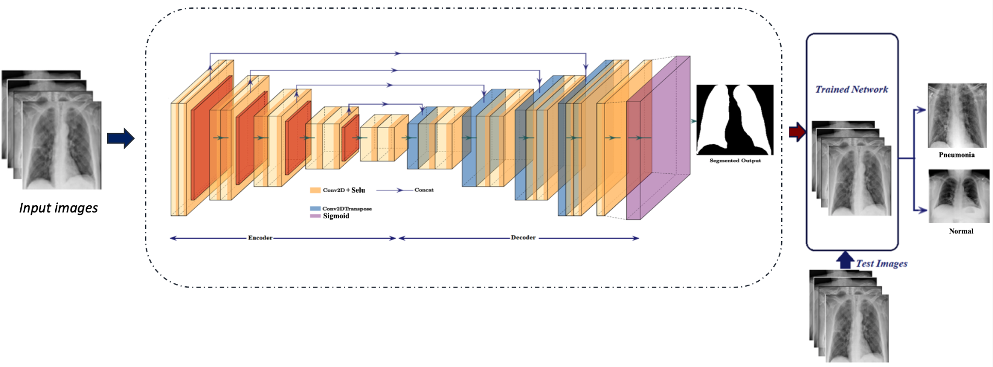
04 Encoder-Decoder
Autoencoder Architecture :
Encoder :
EfficientNet-B4 to encode input images. The fully connected layers, average pooling, and dropout layers of EfficientNet-B4 are removed to obtain a feature representation.
Decoder :
Composed by series of transpose convolutional layers (ConvTranspose2d) followed by SELU activations. It aims to reconstruct the original image from the encoded features. The last layer uses the Sigmoid activation to scale the output between 0 and 1, making it suitable for image reconstruction.
Forward Pass :
Pass input through the encoder, flattening the output, padding it to match the required size, and then passing it through the decoder.
Training the Autoencoder:
Use Cross-Entropy loss and Adam optimizer. The autoencoder is trained to minimize the reconstruction loss.
Notes:
The implementation of Deep Autoencoders is part of an unsupervised feature learning approach which is the main focus of this project. The goal is that the encoder part of the autoencoder compresses the input X-ray images into a lower-dimensional latent space.
The decoder part of the autoencoder reconstructs the input images from the compressed representations. Then, it was made a unsupervised Pre-training to train the autoencoder to minimize the reconstruction loss, encouraging the model to learn valuable features in an unsupervised manner. Then, we used the training set of X-ray images to train the autoencoder. The encoder part of the trained autoencoder serves as a feature extractor for the classification task.

Slide 7
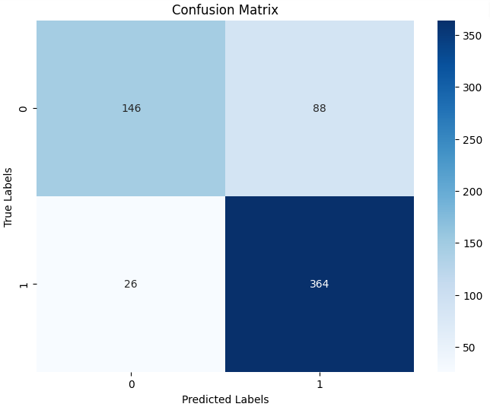
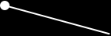
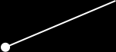
04 Encoder-Decoder
Workflow:
First we train autoencoder for 10 epochs, extract features using the trained autoencoder, and train a binary classifier using the encoded features. Additionally, we included the evaluation of the binary classifier on validation and test sets, as well as the visualization of the confusion matrix.
Train and Validation Results:
Train Loss: 0.3327 ;
Train Accuracy: 85.98%;
Train Precision: 89.39%;
Train Recall: 92.06%;
Train F1: 90.70%
Val Loss: 0.3247;
Val Accuracy: 87.16%;
Val Precision: 91.69%;
Val Recall: 90.98%;
Val F1: 91.33%
Test Results:
Loss: 0.4562;
Accuracy: 81.73%;
Precision: 80.53%;
Recall: 93.33%;
F1: 86.46%

Slide 8
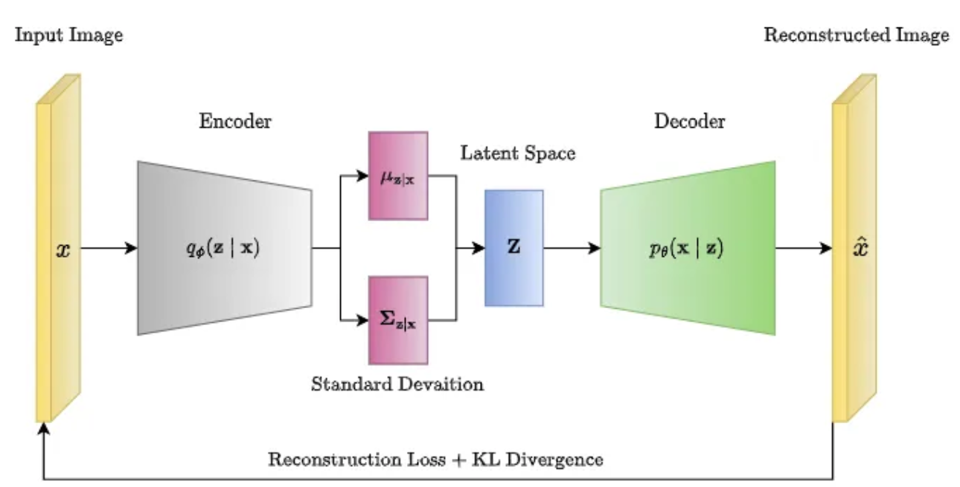
05 VAE
Architecture :
The encoder uses EfficientNet-B4 to encode input images, and fully connected layers are added to compute the mean and log-variance of the distribution in the latent space.
The decoder is a simple fully connected neural network that reconstructs the original image from the latent space.
Reparameterization Trick: Reparameterize method is used to sample from the latent space using the mean and log-variance.
Loss Function: Reconstruction loss (MSE) and a KL divergence term, which encourages the latent space to follow a simple distribution.
Model Training: VAE is trained for 10 epochs using the Adam optimizer.
Extracting Features: Features are extracted from the VAE for both the training and validation sets.
Notes:
Variational Autoencoder is a type of generative model that combines ideas from traditional autoencoders and probabilistic modeling.
In a VAE, the latent space is treated as a probability distribution rather than a fixed vector as in traditional autoencoders. The encoder produces not only the mean but also the variance of a distribution (usually a multivariate Gaussian) in the latent space for each input sample. Sampling is performed in the latent space using the reparameterization trick, which allows for backpropagation through the sampling process. Objective Function:
The VAE objective function consists of two parts: the reconstruction loss and the regularization term (KL divergence). The reconstruction loss measures how well the decoder reconstructs the input. The KL divergence regularizes the latent space, encouraging it to follow a simple distribution (usually a standard Gaussian).

Slide 9
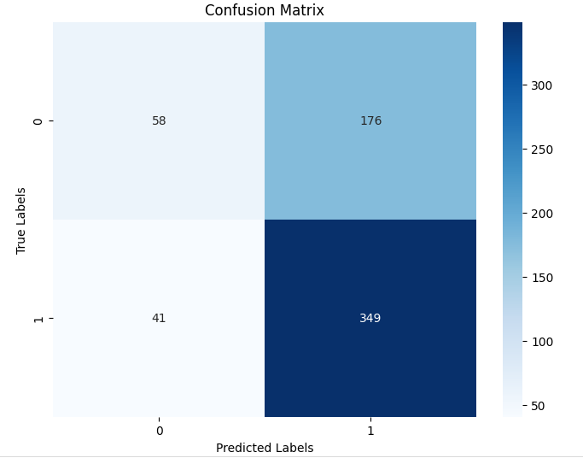
05 VAE
Workflow:
VAE is trained to learn a probabilistic mapping from input images to a latent space, incorporating variational inference for improved generative modeling. The learned latent representations are then utilized to train a binary classifier. The binary classifier is designed using a simple fully connected neural network, and its training involves using the latent features extracted by the pre-trained VAE. The entire pipeline, from VAE trained to binary classifier is then evaluated on validation and test sets.
Train and Validation Results:
Train Loss: 0.4835 ;
Train Accuracy: 76.95%;
Train Precision: 79.19%;
Train Recall: 93.55%;
Train F1: 85.77%
Val Loss: 0.4806;
Val Accuracy: 79.89%;
Val Precision: 83.77%;
Val Recall: 90.46%;
Val F1: 86.99%
Test Results:
Loss: 0.7136;
Accuracy: 65.22%;
Precision: 66.48%;
Recall: 89.49%;
F1: 76.28%

Slide 10
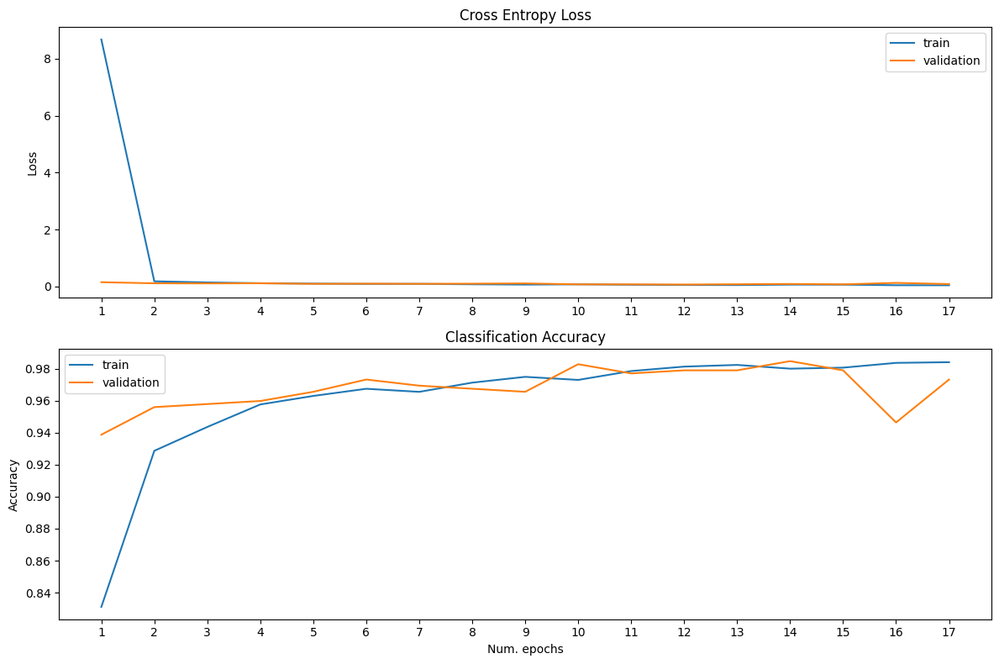
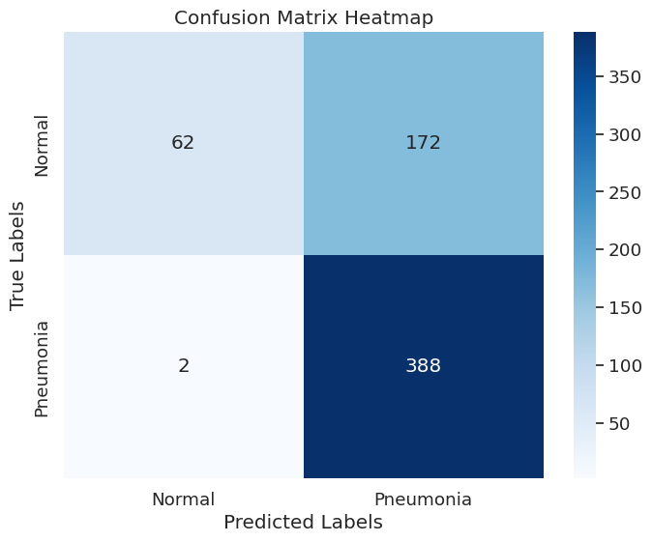
06 Convolutional Neural Network (CNN)
Train Results
Inspired by the human visual system, it excels at processing visual data and capturing local patterns within large images.
Developed architecture:
Based on ConvNet principles for efficient, less complex feature extraction.
Architecture: multiple convolutional and max-pooling layers, ending with a fully connected layer for classification.
Image Size: 256x256 pixels to harness CNN's capacity for more significant inputs.
Hyperparameters:
Adam optimizer; Cross-entropy loss function; Batch size: 32; Learning Rate: 0.01.
Trained for 30 epochs, with an early stopping patience of 5.
Test Confusion Matrix
Train Results:
Early Stop: 17th epoch
The best results, at the 12th epoch, with an accuracy of Train: 98.1% ; Validation: 97.9%.
Test Results:
Loss:1.418; Accuracy:72.1%; Precision:79.6%; Recall:72.1%; F1:66.7%
Notes:
CNNs excel at processing visual data and capturing patterns.
Therefore we decided to develop a custom model based on ConvNet
We opt for multiple convolutional and max-pooling layers for feature extraction and dimensionality reduction, concluding with a fully connected layer for classification.
Hyperparameters were defined like training for 30 epochs, with an early stopping, to prevent overfitting.
As for the results:
- on training, after twelve epochs our model is performing reasonably well for train and validation accuracy
- but for testing, the accuracy is below validation accuracy which suggests that the model is overfitting and can struggle to generalize to new unseen data
- In the confusion matrix, we can observe that for instance that two "Pneumonia" labels were misspredited as "Normal”,

Slide 11
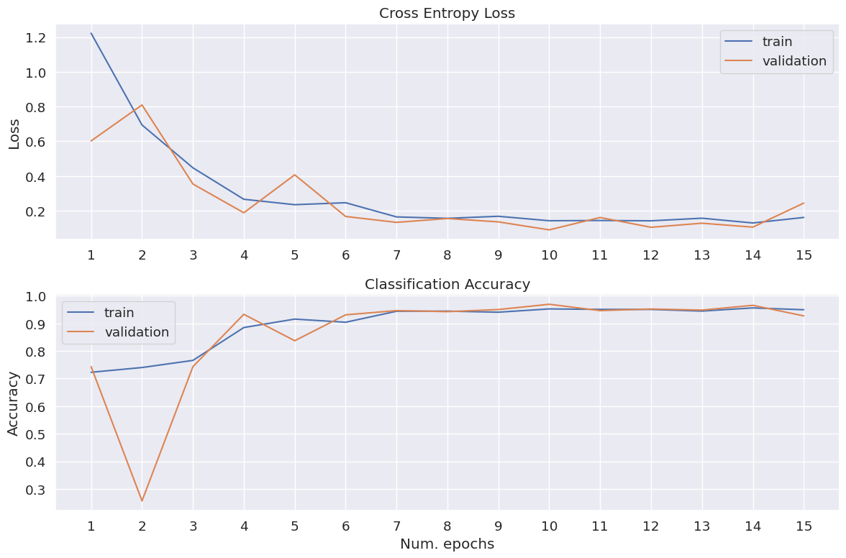
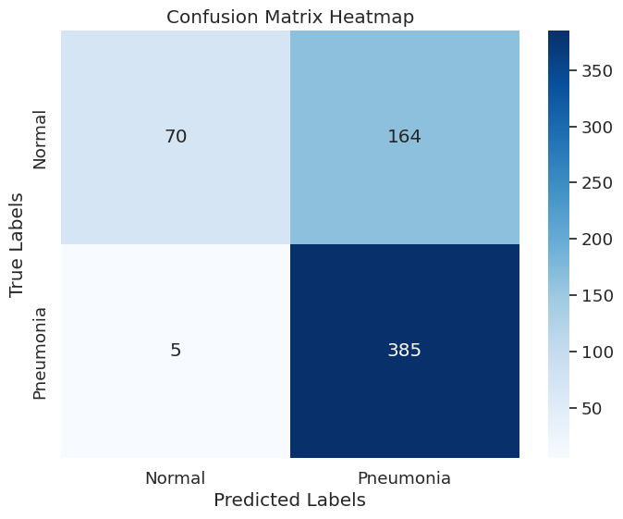
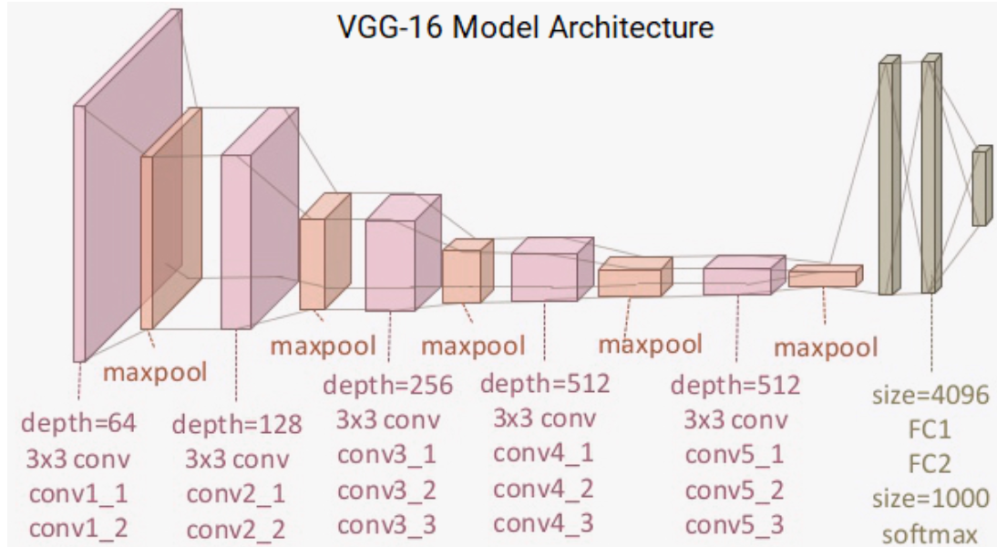
07 Transfer Learning Models
07.01 VGG16
Train Results
It is known for its simplicity and effectiveness in image classification.
Extensively trained on ImageNet, enabling detailed feature extraction for low-level visual details.
Test Confusion Matrix
VGG16 defined hyperparameters:
Adam optimizer; Cross-entropy loss function; Batch size: 32, Learning Rate: 0.001 with a step size of 10 epochs; Momentum: 0.9; Weight Decay of 0.01.
Trained for 30 epochs, with an early stopping patience of 5.
Train Results:
Early Stop: 15th epoch
The best results, at the 10th epoch, with an accuracy of Train: 95.2% ; Validation: 96.9%.
Test Results:
Loss:0.836; Accuracy:72.9%; Precision:78.8%; Recall:72.9%; F1:68.9%
Notes:
The VGG series is known for its simplicity and effectiveness in image classification.
Therefore, we decided to utilize VGG16 for its pre-trained feature extraction for low-level visual details, requiring minimal additional training.
Some hyperparameters were defined and we kept the training epochs logic already implemented in CNN
As for the results:
- on training, after ten epochs, our model is performing reasonably with a train and validation accuracy of around 95.5%
- for testing, as in CNN, we observe that the accuracy value is below validation accuracy and, therefore, can imply that the model is overfitting and can struggle to generalize to new unseen data
- From the confusion matrix, we can conclude that the labels "Pneumonia" and "Normal” were mispredicted 5 and 164 times, respectively.

Slide 12
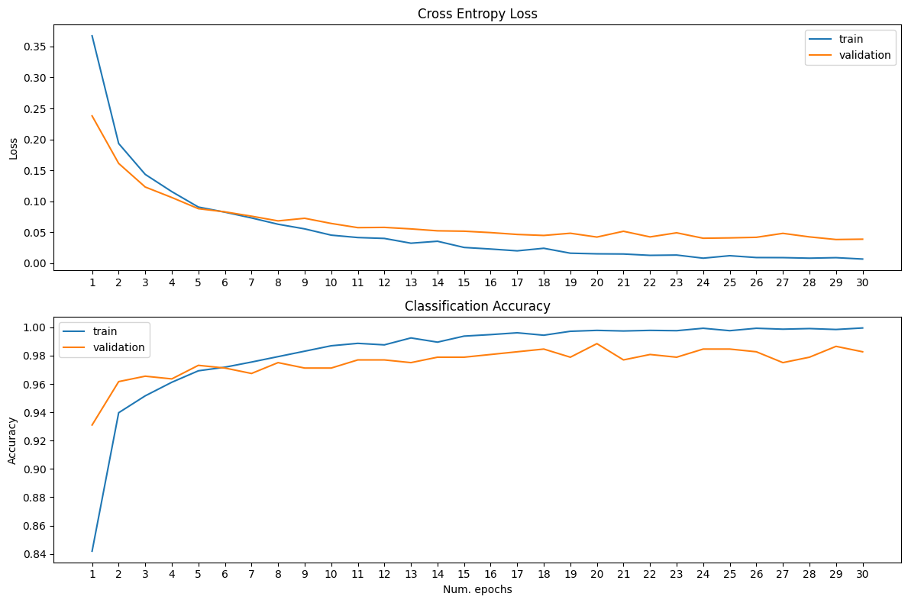
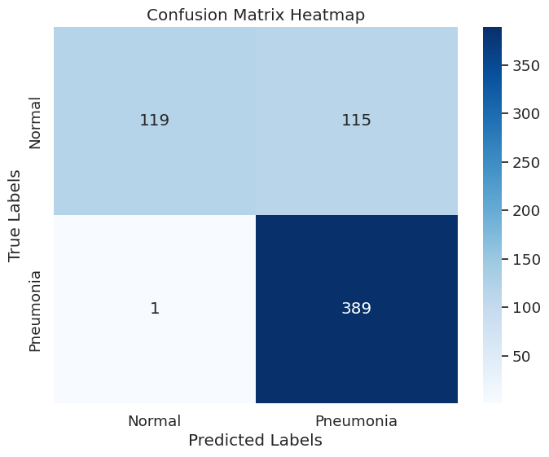
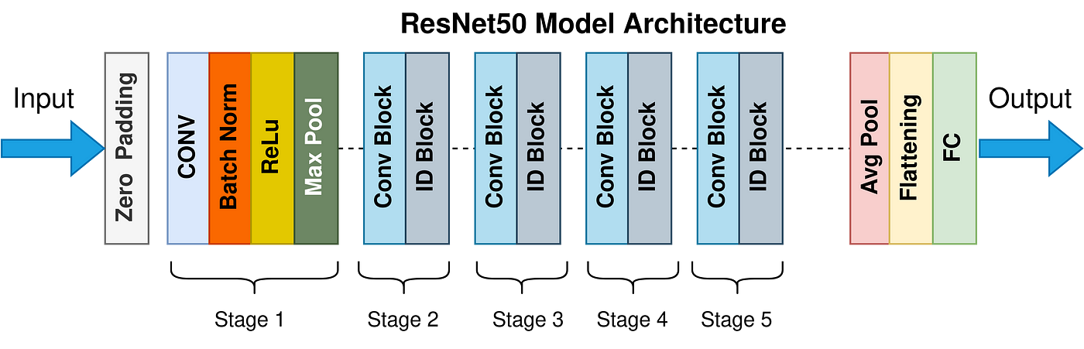
07.02 ResNet
Initialization:
Cross-entropy loss function suitable for multi-class classification.
Optimizer and Scheduler Setup:
Adam optimizer.
Learning rate scheduler: 0.001
Batch size: 32
Training:
30 epochs.
Train Results:
Best results: Epoch 29th
Train acc: 99,9%
Validation acc: 98,7%
Test Result:
Test Loss: 0.691
Test Accuracy: 81.4%
Test Precision: 85.4%
Test Recall: 81.4 %
Test F1: 79.6 %
Notes:
ResNet (Residual Networks) is a deep neural network architecture introduced to enable training of very deep networks by addressing the vanishing gradient problem.
It employs residual blocks with shortcut connections to facilitate the learning of residual functions, making it easier to optimize deep models.
We define the loss function as cross-entropy, suitable for multi-class classification problems.
Then, we set up the Adam optimizer and introduce a learning rate scheduler of 0.001, which reduces the learning rate by a specified factor every certain number of epochs and a batch size of 32.
Once this is done, we train our ResNet with 30 epochs.

Slide 13
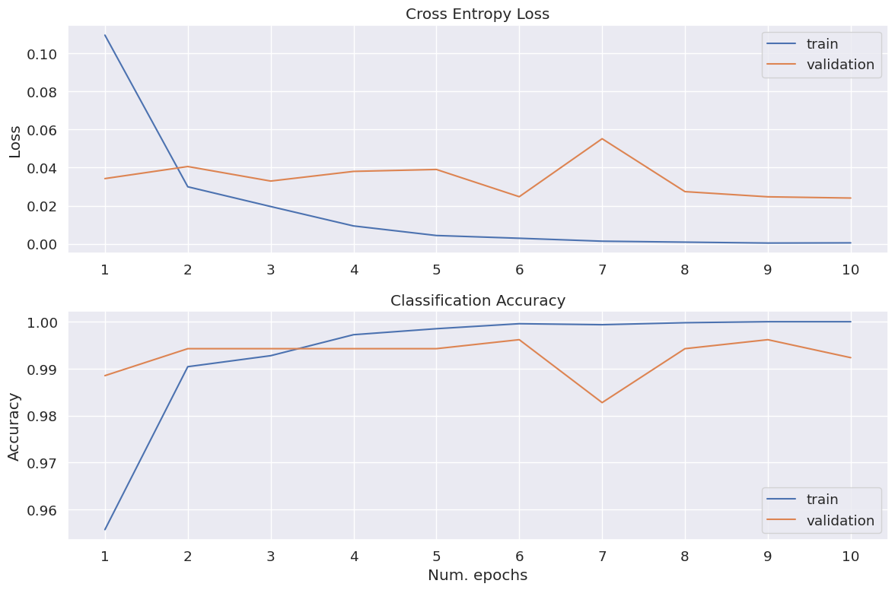
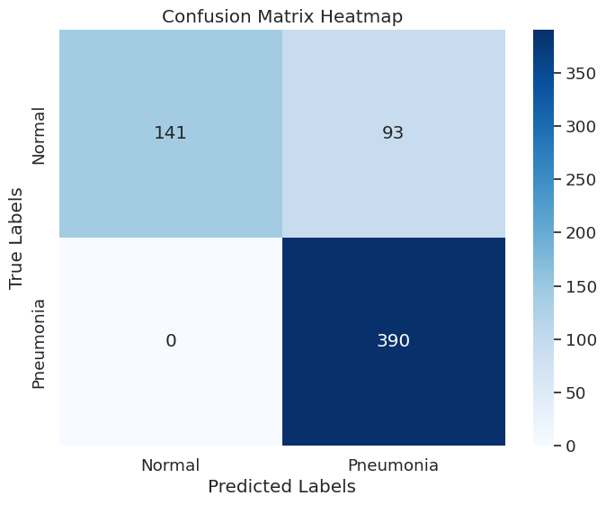
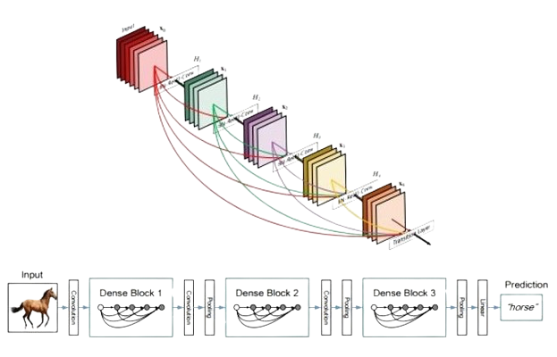
07.03 DenseNet
Initialization: Define the loss function as cross-entropy for multi-class classification.
Optimizer and Scheduler Setup: Adam optimizer; Learning rate scheduler: 0.005; Momentum: 0.9; Batch size: 32
Training Configuration: 10 epochs.
Train Results
Test Confusion Matrix
Train Results:
The best results, at the 10th epoch, with an accuracy of Train: 100% ; Validation: 99,6%.
Test Results:
Loss:1.118 ; Accuracy:85.1%; Precision: 88.0%; Recall:72.1%; F1:84.0%
Notes:
DenseNet (Densely Connected Convolutional Networks) is a neural network architecture where each layer receives direct input from all preceding layers, promoting feature reuse and parameter efficiency.
It utilizes densely connected blocks, incorporating dense connections to enhance information flow across the network.
We initialize with loss function is cross-entropy, specifically designed for multi-class classification tasks, with Stochastic Gradient Descent (SGD) optimizer with a learning rate of 0.005 and momentum of 0.9. Additionally, we employ the Adam optimizer and implement a learning rate scheduler, which we trained with 10 epochs.
—-
After a more in-depth analysis, the epochs 10th emerges as promising candidates for optimal model selection with a train accuracy of 100%, validation accuracy of 99.2% and a test accuracy of 85.7%
It suggests strong performance, but potential overfitting should be addressed due to the perfect training accuracy and a notable difference with validation/test accuracy.

Slide 14
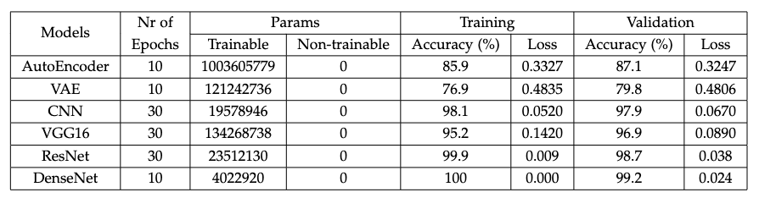
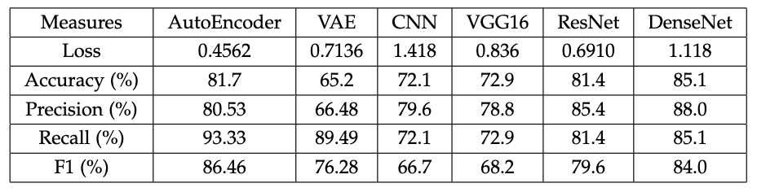
08 Results
DenseNet achieved a testing accuracy of 85.1%, with excellent precision and recall, demonstrating its robustness across several metrics, but high accuracy on train show a tendency to overfitting.
Resnet a test accuracy of 81.4% with a good balance in precision and recall, demonstrating its dependability.
The AutoEncoder, while showing a moderate drop in testing accuracy excelled in recall, making it very efficient in identifying relevant cases. Same can be said for VAE despite their lower overall accuracy and precision.
CNN and VGG16 results suggests that the models are experiencing overfitting in the data.
Training and Validation parameters and results comparison per model
Testing results comparison per model
Notes:
This tables give us a look on the overall results of our models, leading us to the following conclusions:
DenseNet and ResNet stood out, from the remain models, both with very good testing accuracy.
The 1st showing robustness across several metrics and the 2nd demonstrating dependability.
Regardless DenseNet accuracy on train shows a tendency to overfitting
AutoEncoder showed a test accuracy drop, but excelled at recall, making it very efficient in identifying relevant cases, and the same can be said for VAE despite their lower precision and recall
On other hand, CNN and VGG16 models experienced a significant performance drop in testing, despite their high training accuracy, suggesting overfitting.
With this we can conclude that:
For model selection, models such as DenseNet and Resnet may be more adequate due to their balance performance across different metrics
AutoEncoder and VAE might be more suitable if the objective is to find as many cases as possible

Slide 15
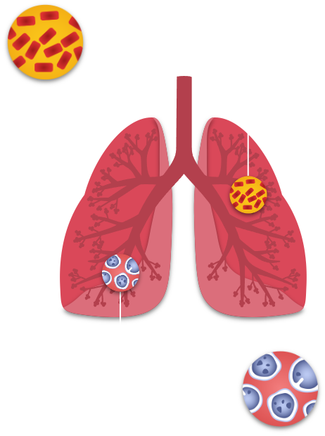
09 Conclusion
Traditional diagnosis relies heavily on interpreting chest X-rays, which can be complex and subtle, requiring expertise and experience. With this project, we hope to contribute valuable insights into applying deep learning in medical imaging, paving the way for more advanced, reliable, and efficient diagnostic tools. Our exploration of various deep-learning models highlights the trade-offs between precision, recall, and accuracy in medical image analysis.
It’s important to note that these models should be used as decision support tools, and qualified healthcare professionals should always confirm the final diagnosis.
For the future work, can include the enhancement of hyperparameters, using advanced deep learning architectures, or hybrid models that can combine strengths with the ones used in this project.
Notes:
Expanding, diversifying the dataset, and focusing on data augmentation should be another goal. Plans to make these models interpretable for healthcare professionals, conduct real-world clinical trials integrating them into healthcare IT systems, and try to adapt them for use in low-resource settings should also be considered.

Slide 16
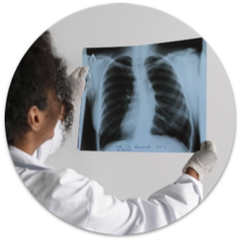
Q&A
Thanks for your presence!
Notes:
We arrive at the end of this presentation that explains our paper's main topics and principles.
Thank you for watching.
If there still any questions left, please feel free to reach us.

